Slide 1
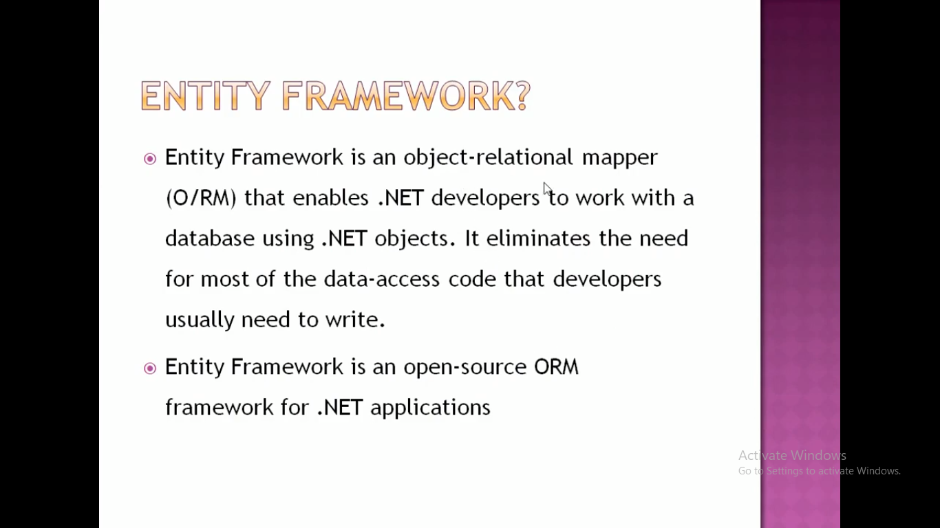

Slide 2
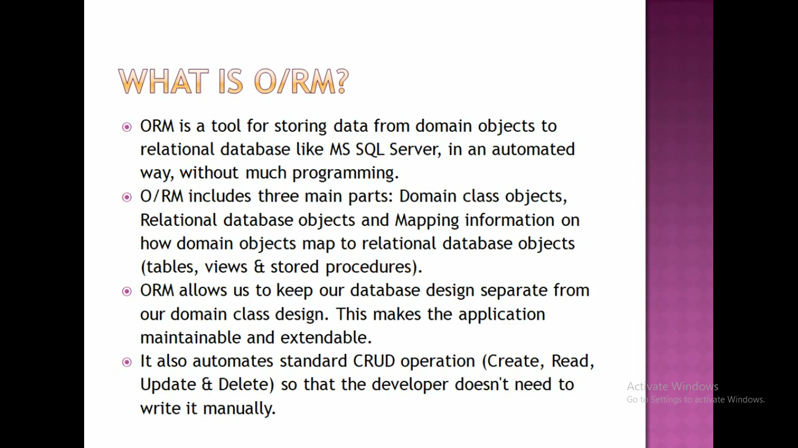

Slide 3
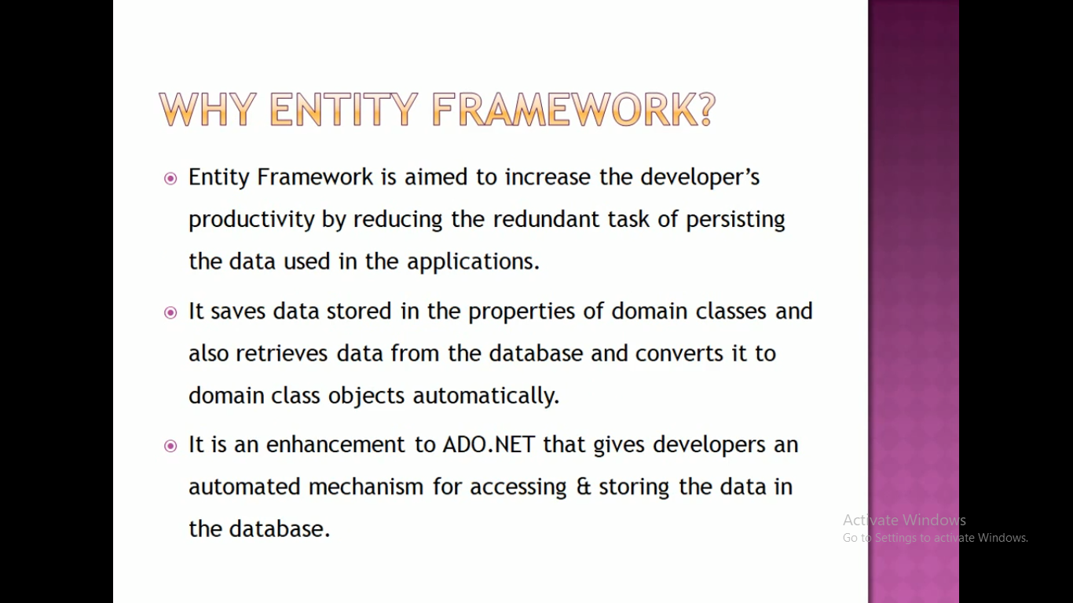

Slide 4
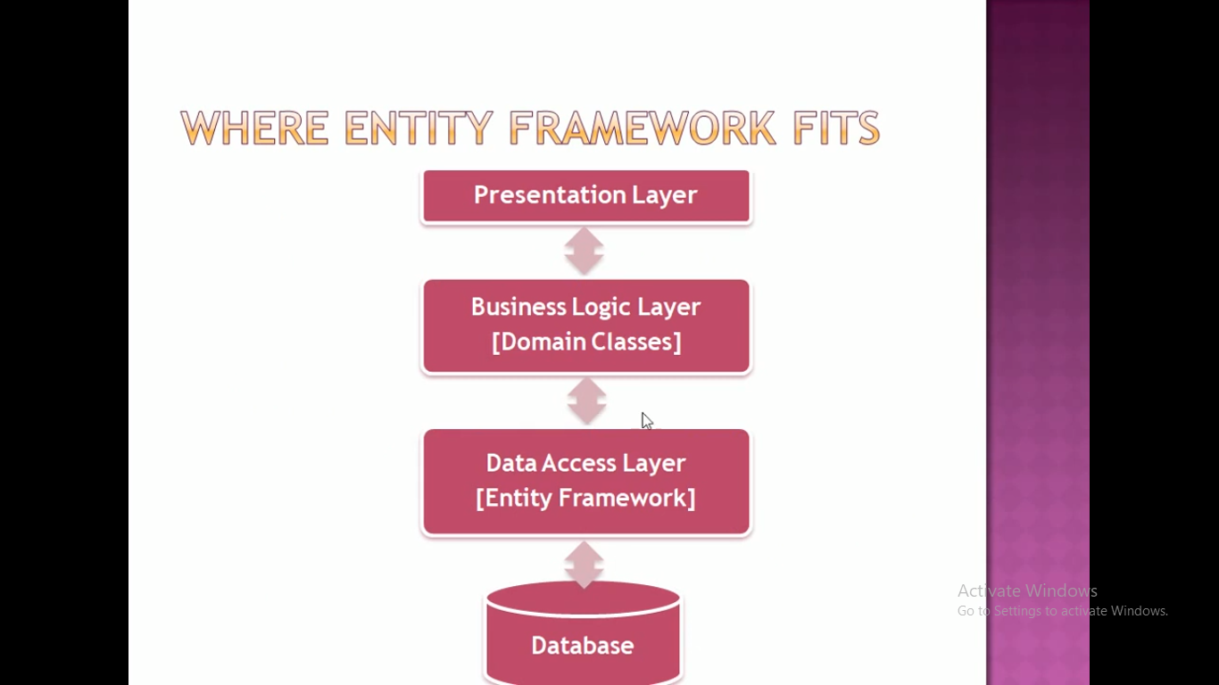

Slide 5
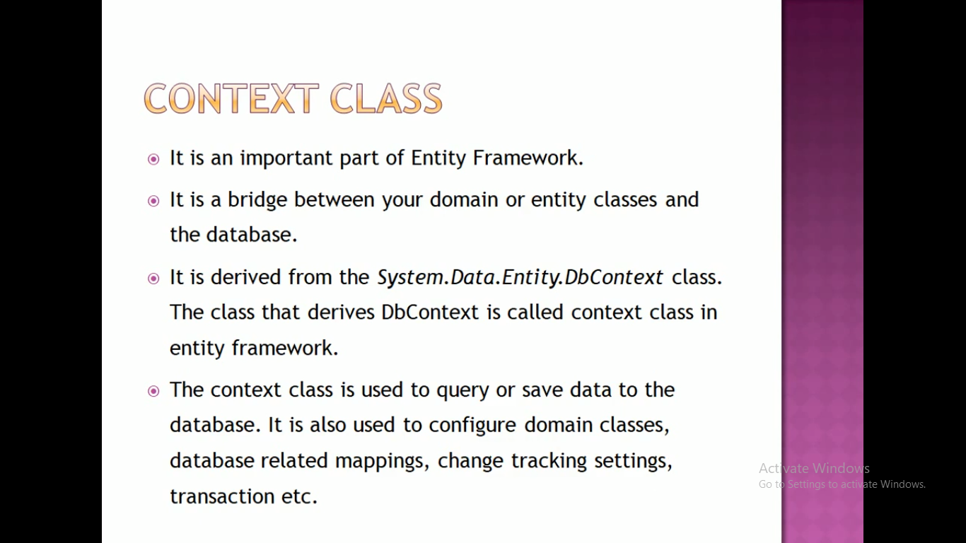

Slide 6
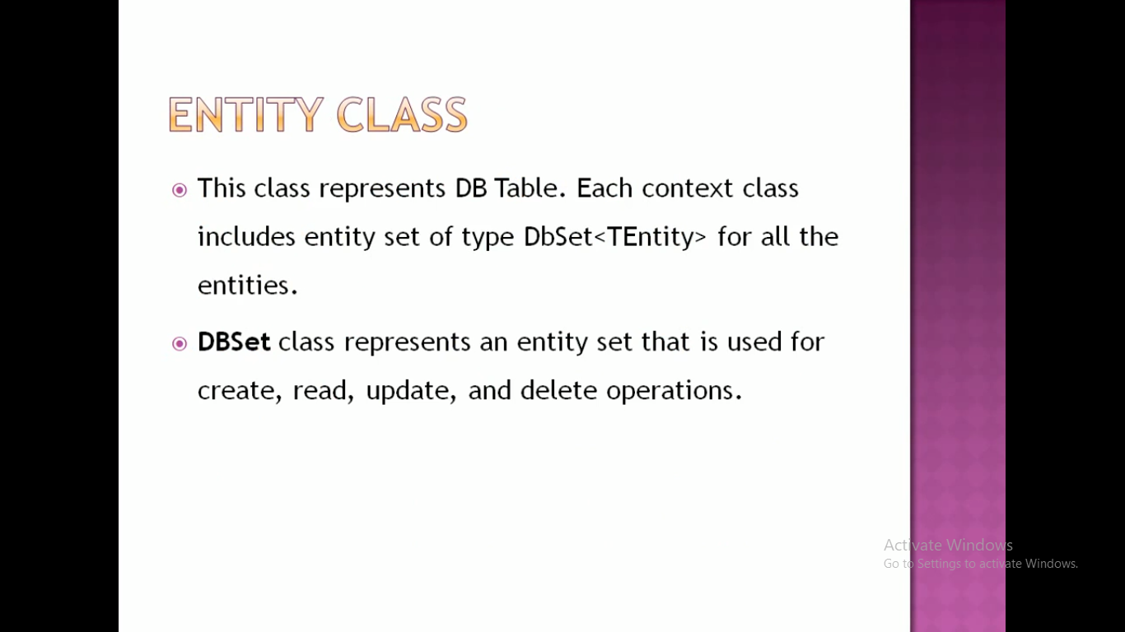

Slide 7
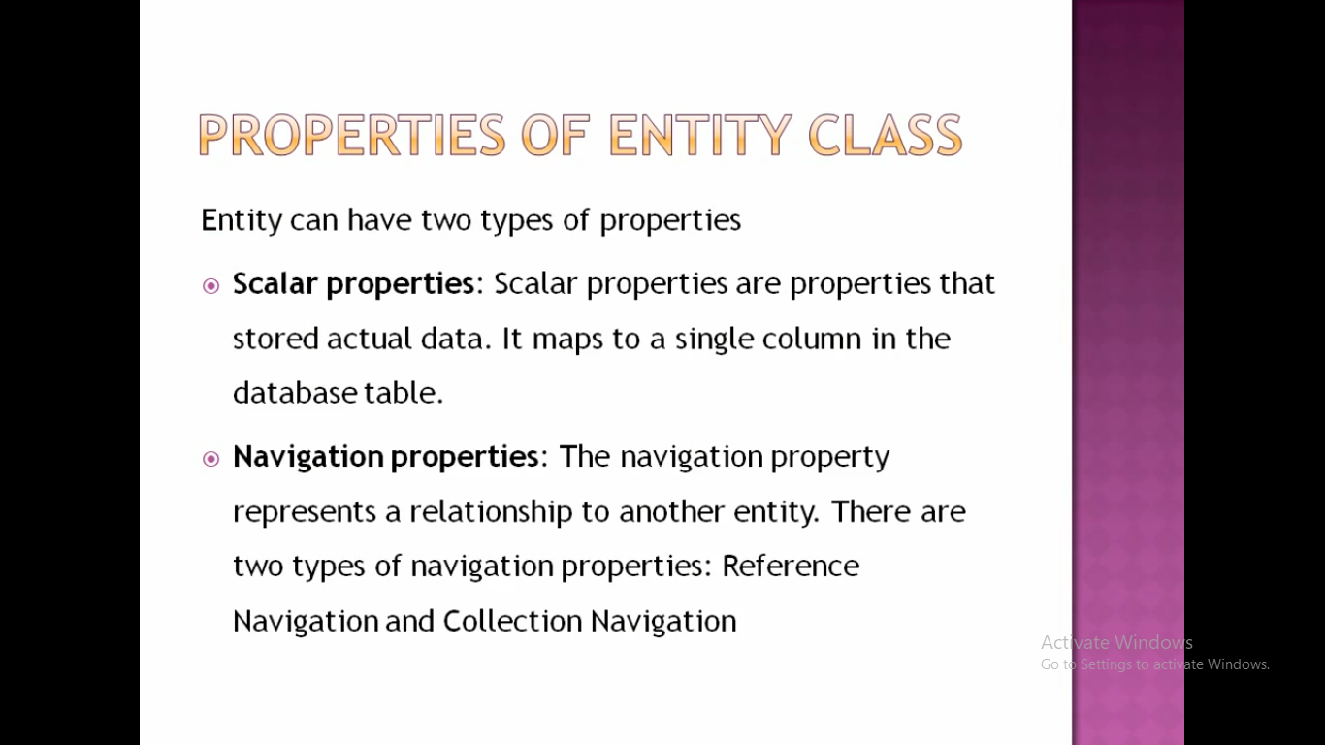

Slide 8
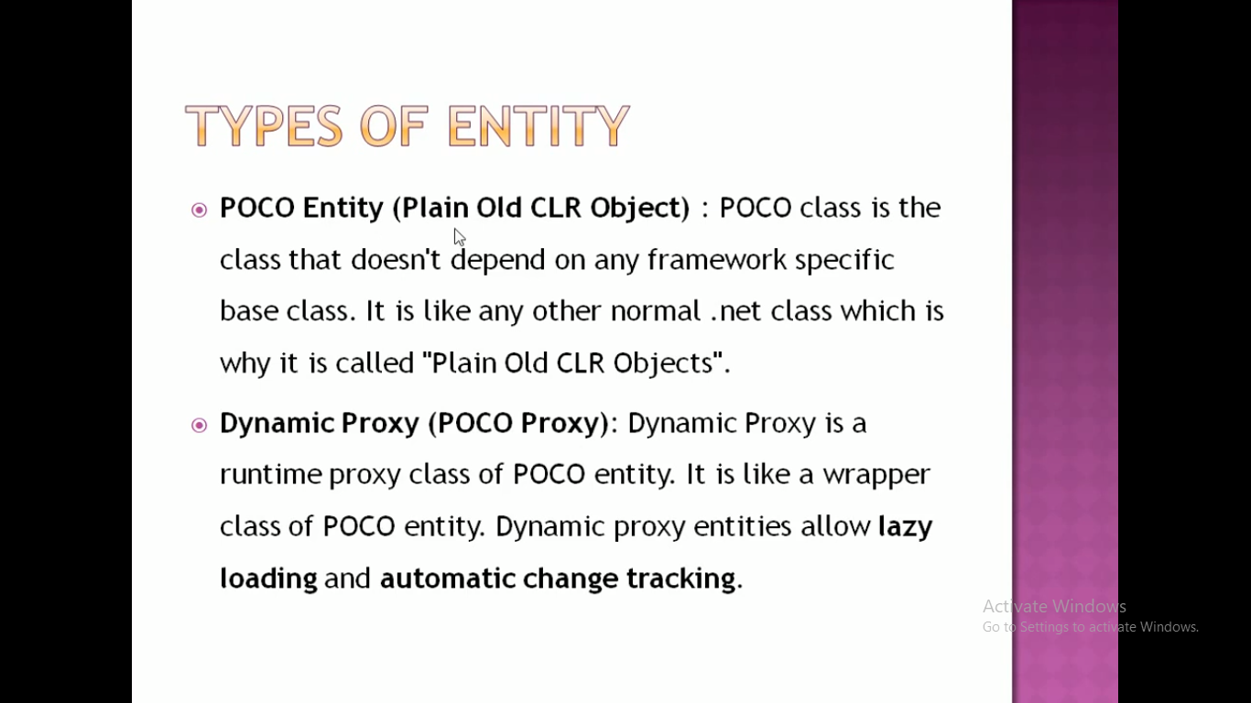

Slide 9
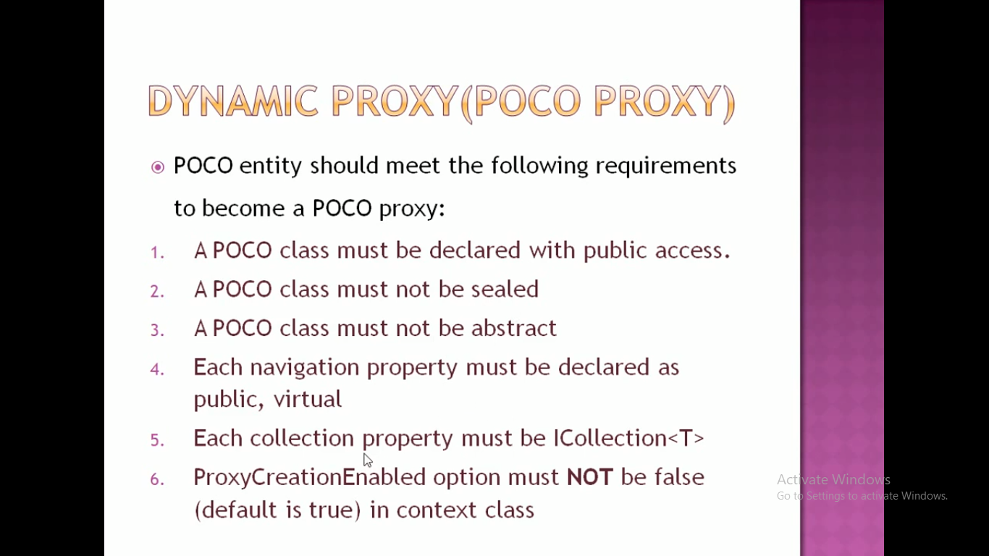

Slide 10
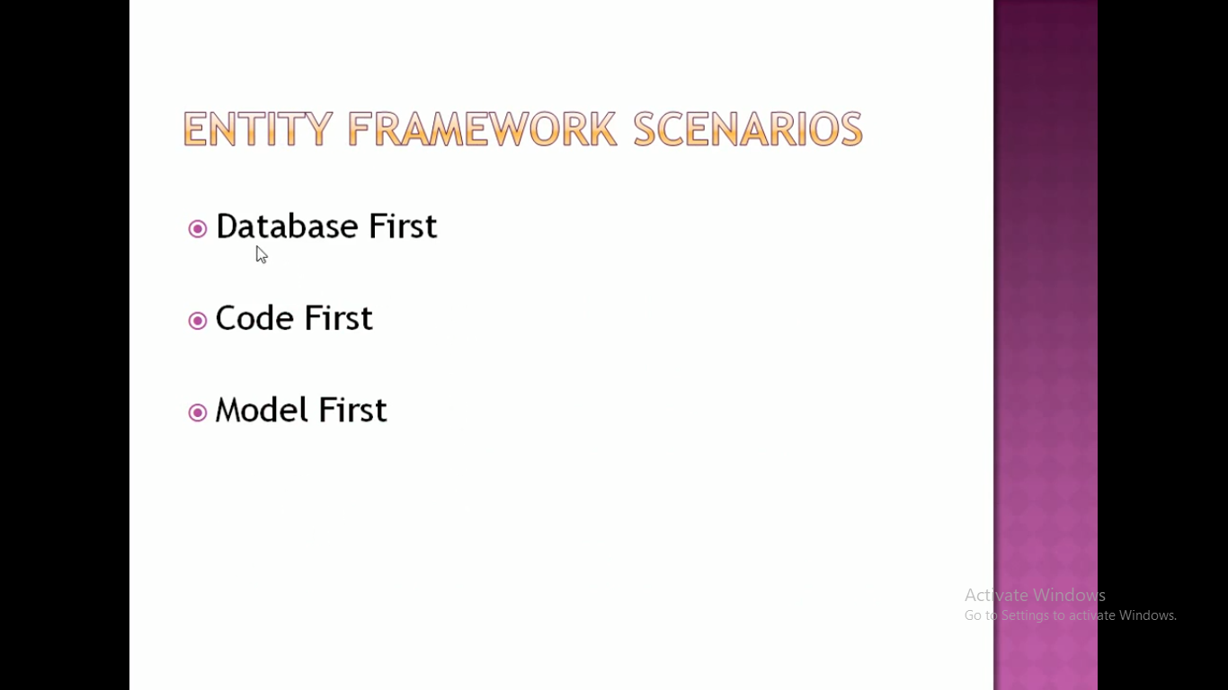

Slide 11
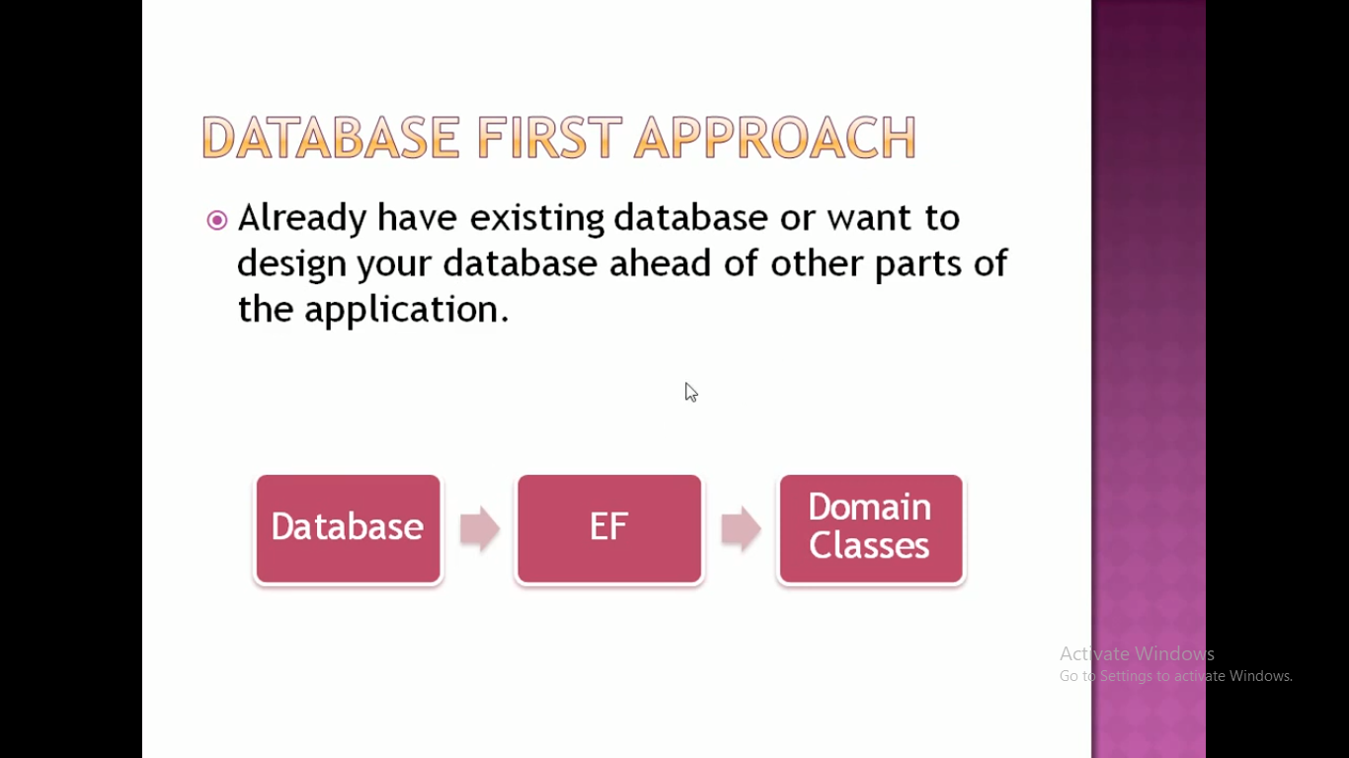

Slide 12
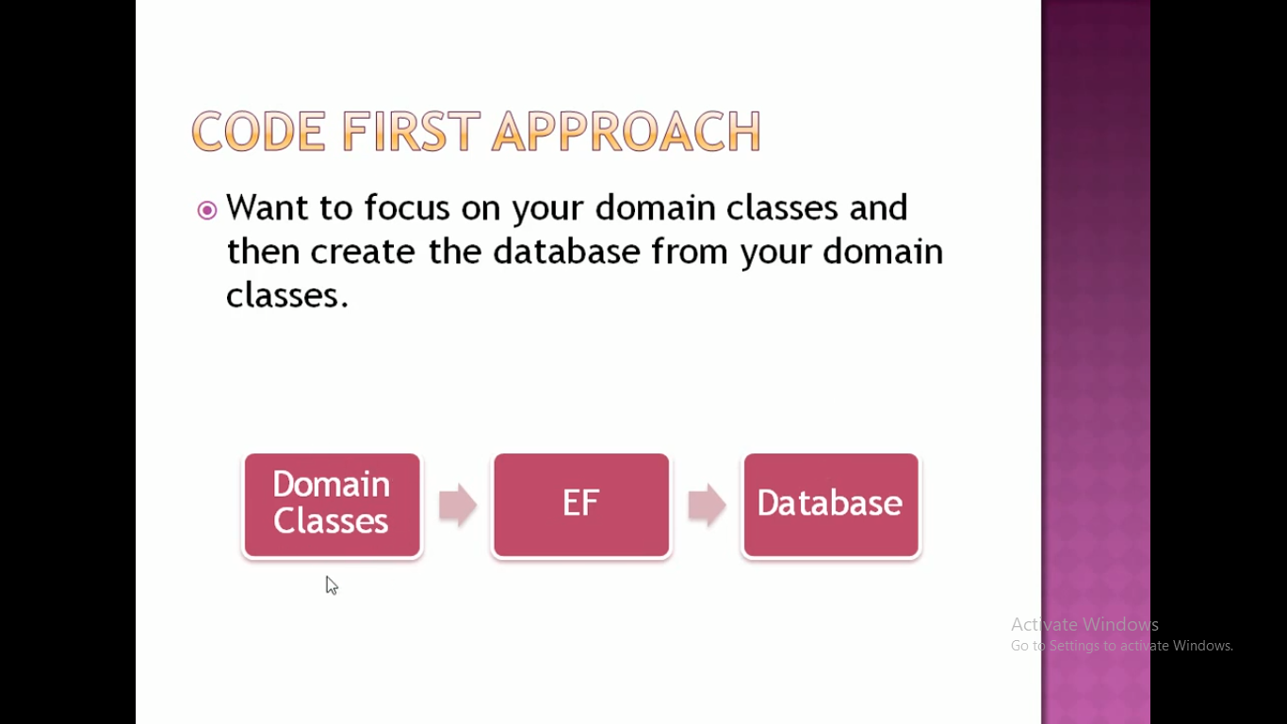

Slide 13
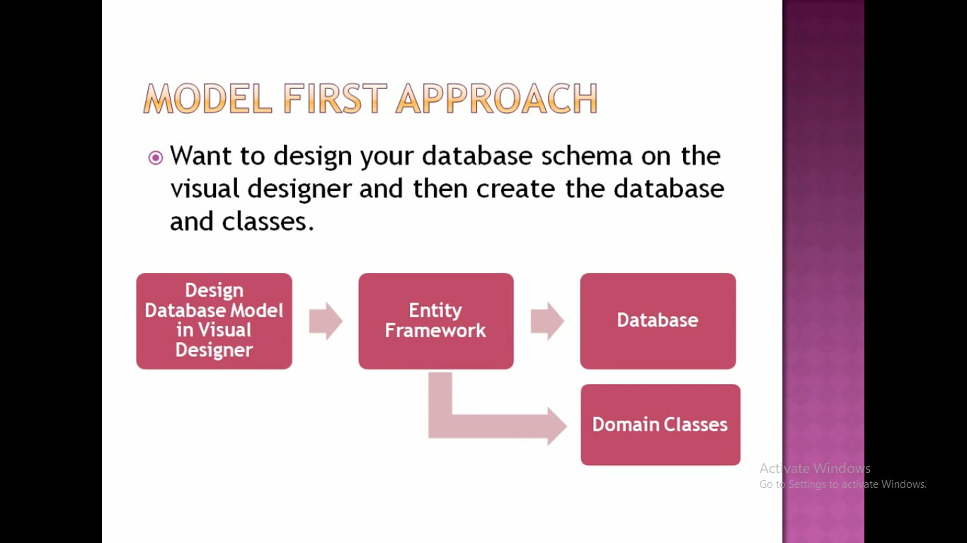

Slide 14
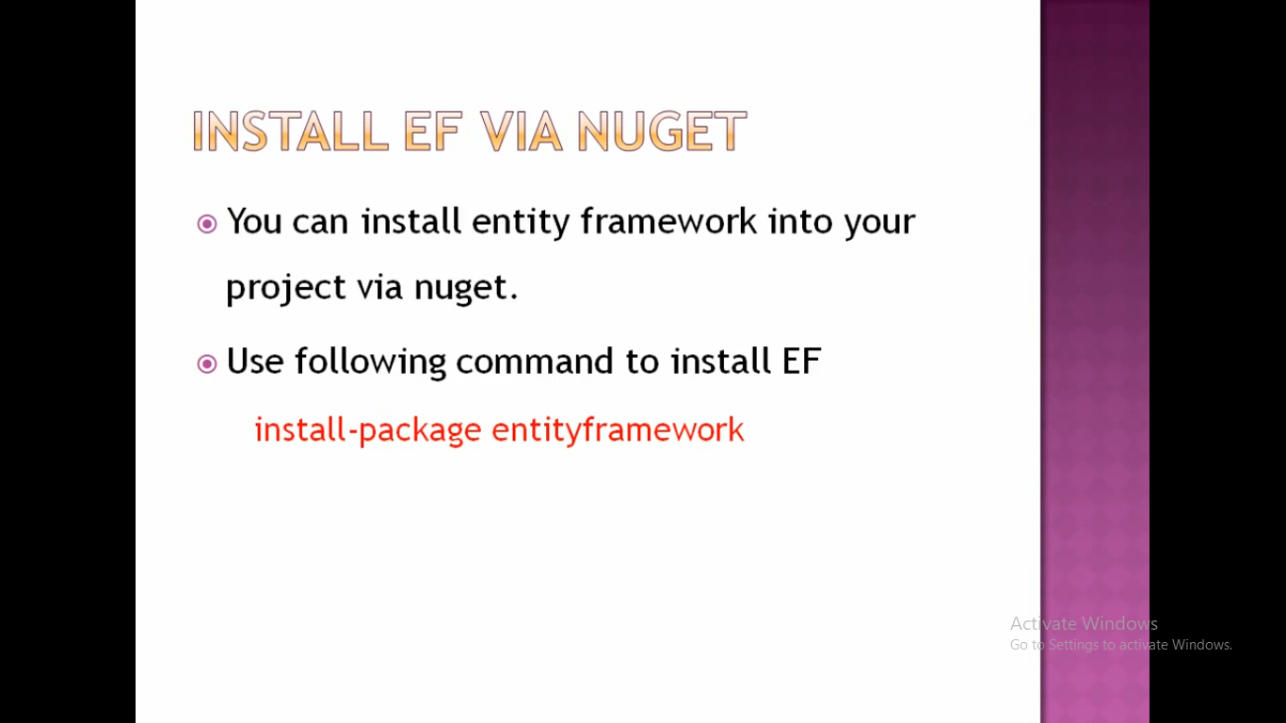

Slide 15
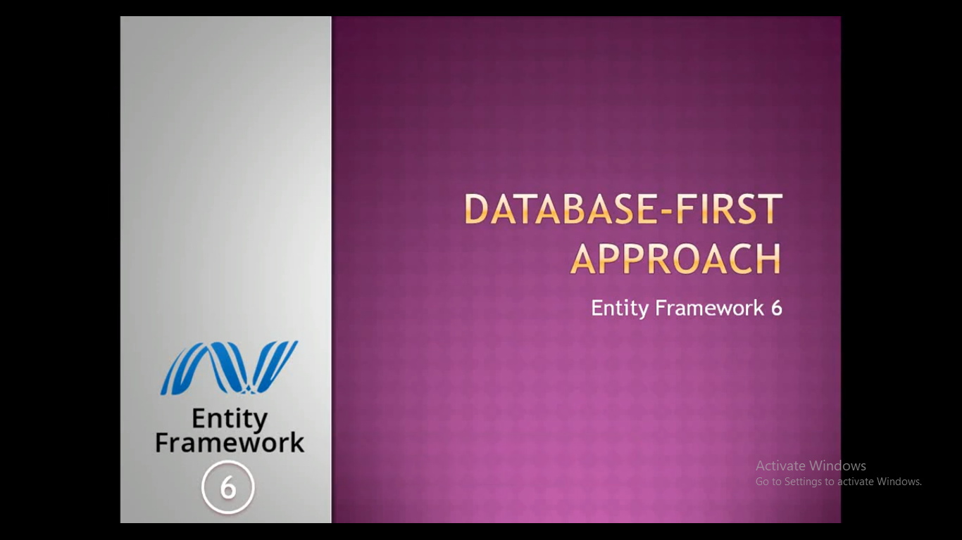

Slide 16
CREATE TABLE Areas (
AreaId int NOT NULL PRIMARY KEY,
AreaName nvarchar(max) NOT NULL,
CityId int NOT NULL FOREIGN KEY REFERENCES Cities(CityId)
);
As we are using Console Application the setting will be added in App.config file in case of Web Application it get added in webConfig File
Pluralize means Areas will be converted to Area.
If we want to see the edmx diagram in XML form just right click on edmx file => open with=>XML Text Editor
Suppose we want to view all the objects that are included from the DB , use Model Browser, click anywhere and select Model Browser(It is Divided into three Parts as like XML 1. Conceptual Model(Information in form of Classes), Storage Model(Information in form of Tables) 3. Mapping
To View a Mapping of a particular entity to a Table click on that edmx diagram or right click on that box and see mapping

Slide 17
There are Two Important Class
1. Context Class- Acts as a Bridge Between DB and entity Classes
2. Entity Class
public partial class MyDbEntities : DbContext(If it is inheriting from DBContext class then only it is a Context class
It Has a constructor
public MyDbEntities()
: base("name=MyDbEntities")
It is calling fom base class constructor and it is fetching connectionstring from the App config file
protected override void OnModelCreating(DbModelBuilder modelBuilder)
Here we specify the configuration of Entity Classes
public virtual DbSet<Area> Areas { get; set; }
Using this Dbset we can Perform all CRUD operation.

Slide 18
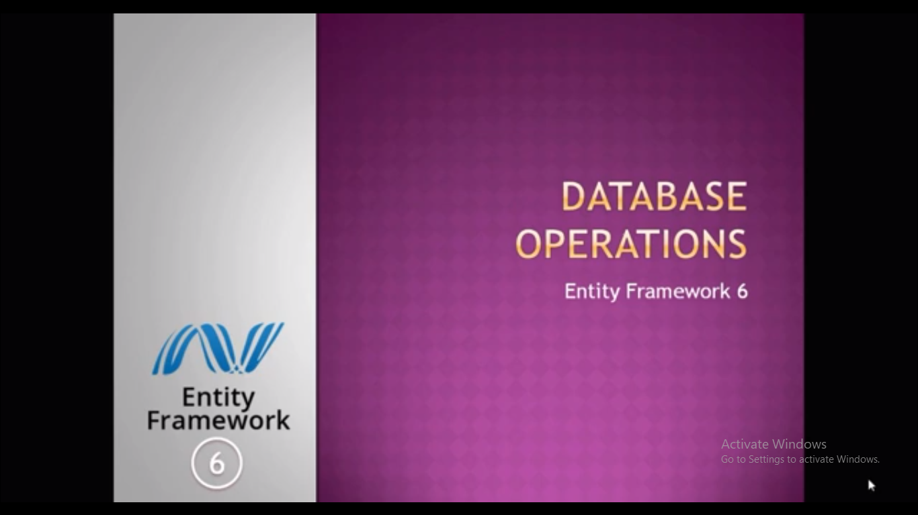

Slide 19
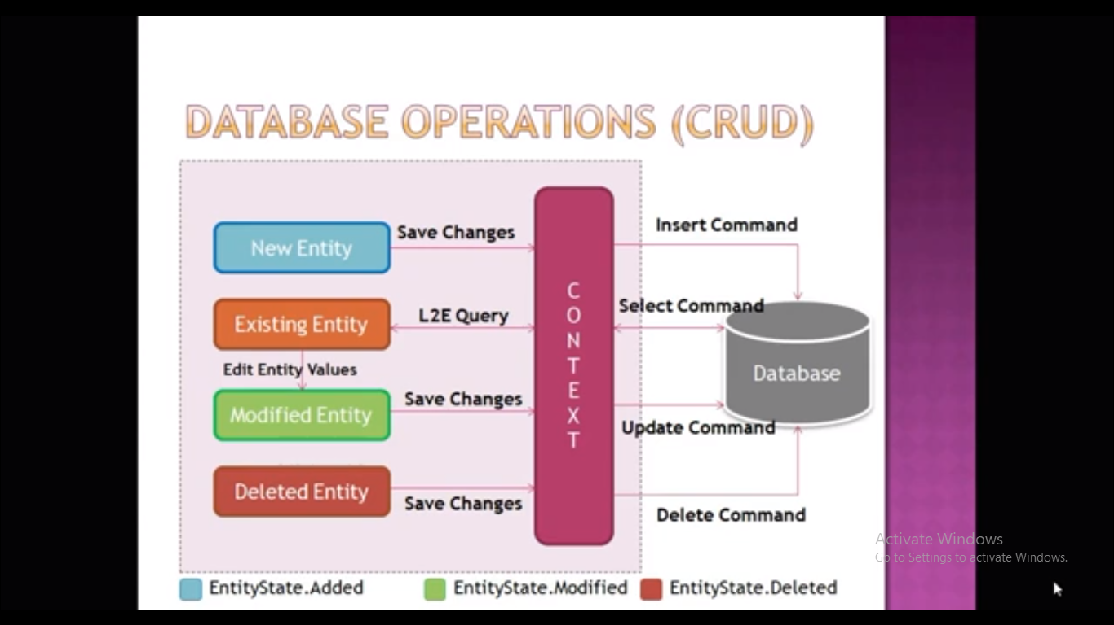

Slide 20
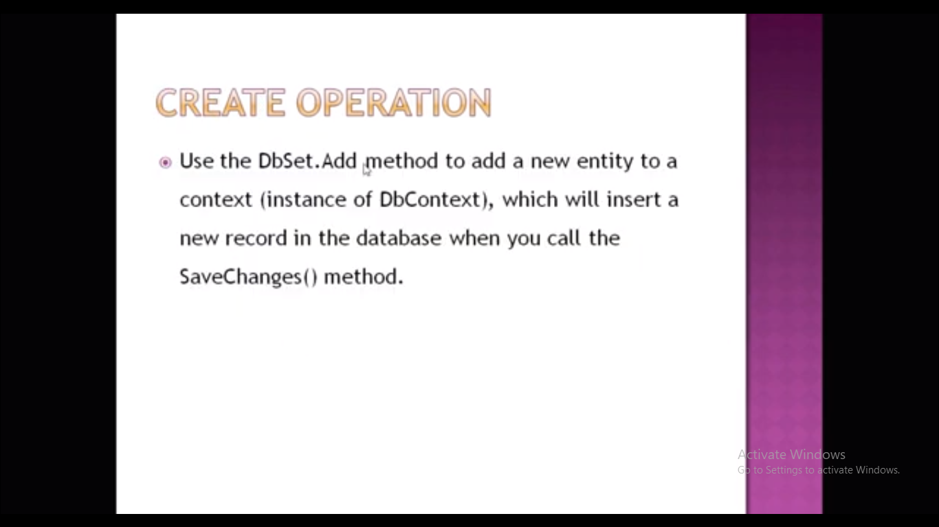

Slide 21
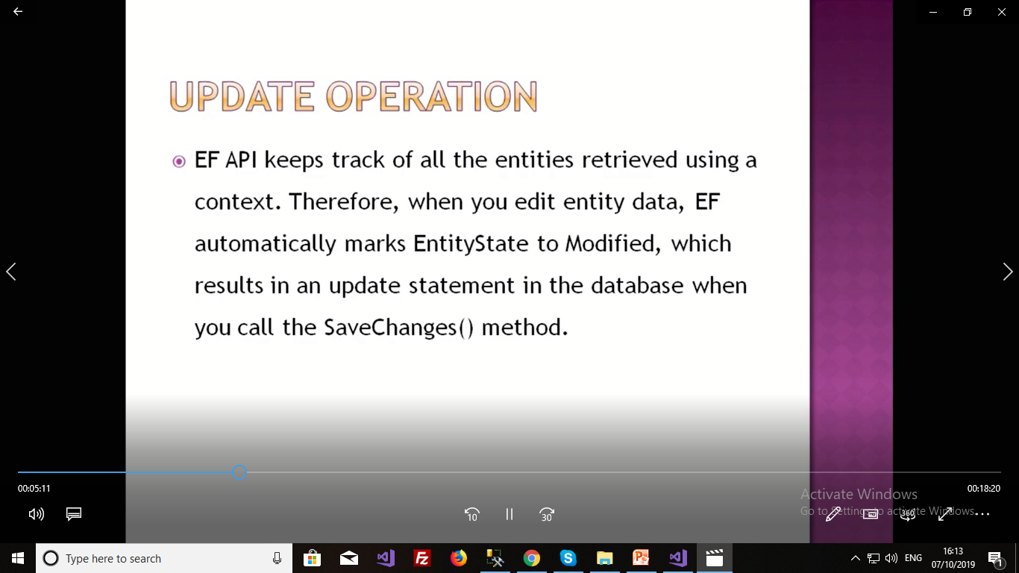

Slide 22
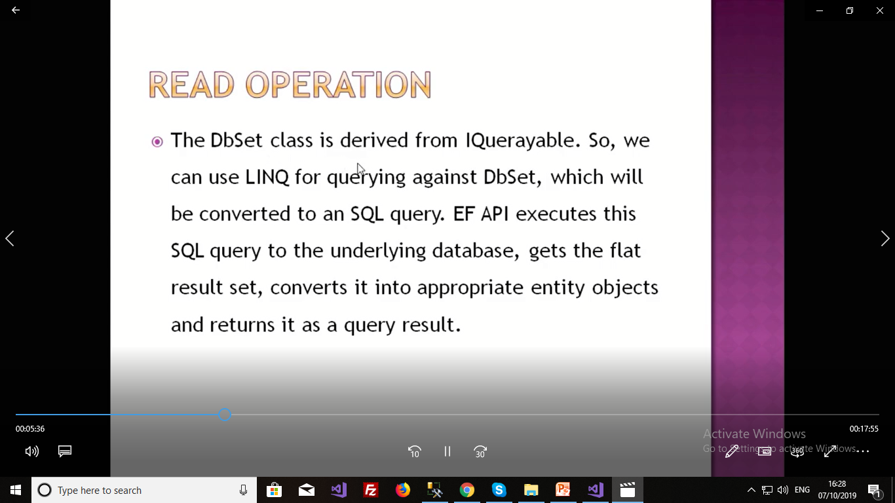

Slide 23
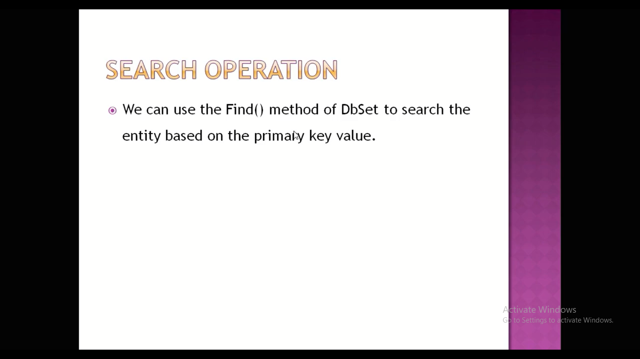

Slide 24
For doing CRUD operation using DB first Approach we have to create a DB in which there is a two table 1. Areas and City
City has Two Coloums CityId(PK,int, not null) and CityName(nvarchar(max), not null)
Areas has 4 columns1. AreaId(PK, int, not null), Area Name(nvarchar(max), not null), CityId(FK,int, not null) Pincode(varchar(6), not null)
Then We have to create a new project=> Visual C#=>Console Application(Framework 4.6 or Above)
Then Add Entity Data Model,
Right Click on Project => add New Item=>ADO.net Entity Data Model=>Name it as Location=>EF Designer from DB=>Create new Connection => test succesded=>App.Confifname(MyDbEntities)=>version 6.x=>Select Tables=>Model Namespace name=>MyDbModel
If u do any changes in DB just go to edmx diagram and click update from DB
Enter City Id and City Name
Then Add CRUD.CS file which is down at the next slide

Slide 25
using System;
using System.Collections.Generic;
using System.Linq;
using System.Text;
using System.Threading.Tasks;
namespace DatabaseFirst
{
class CRUD
{
public static void Main(string[] args)
{
MyDbEntities db = new MyDbEntities();
Area areaObj = new Area();
int opt, id;
do
{
Console.WriteLine("1:New Record\n 2:Display\n3:Update Record \n4:Delete Record\n 5:Exit");
Console.Write("Enter Your Option");
opt = Convert.ToInt32(Console.ReadLine());
switch (opt)
{
case 1:// add new Record
Console.WriteLine("Enter Area Name, CityId and Pincode:");
areaObj.AreaName = Console.ReadLine();
areaObj.CityId = Convert.ToInt32(Console.ReadLine());
areaObj.Pincode= Console.ReadLine();
db.Areas.Add(areaObj);
db.SaveChanges();
break;
case 2:// read all Records
foreach (Area a in db.Areas)
{
Console.WriteLine("{0}\t{1}\t{2}\t{3}", a.AreaId, a.AreaName, a.Pincode,a.City.CityName);
}
break;

Slide 26
case 3:// update Records
Console.Write("Enter Id to Update:");
id = Convert.ToInt32(Console.ReadLine());
areaObj=db.Areas.Find(id);
if (areaObj == null)
{
Console.WriteLine("Invalid Area Id, Try Again");
}
else
{
Console.WriteLine("Enter Modified Area Name, CityId and Pincode:");
areaObj.AreaName = Console.ReadLine();
areaObj.CityId = Convert.ToInt32(Console.ReadLine());
areaObj.Pincode = Console.ReadLine();
db.SaveChanges();
}
break;
case 4:// delete Records
Console.Write("Enter Id to Delete:");
id = Convert.ToInt32(Console.ReadLine());
areaObj = db.Areas.Find(id);
if (areaObj == null)
{
Console.WriteLine("Invalid Area Id, Try Again");
}
else
{
db.Areas.Remove(areaObj);
db.SaveChanges();
}
break;
case 5:break;
default:Console.WriteLine("Invalid Option ");break;
}
}while(opt!=5);
}
}
}

Slide 27
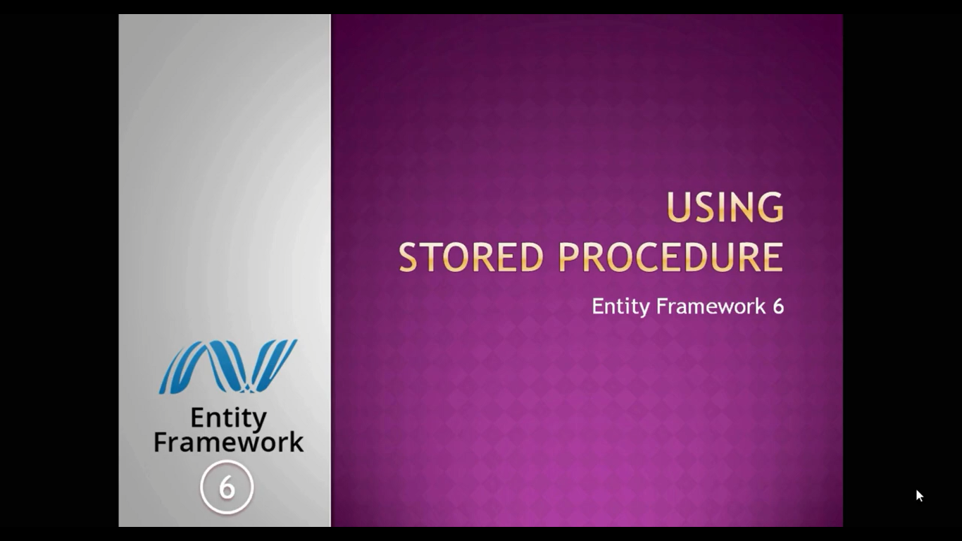

Slide 28
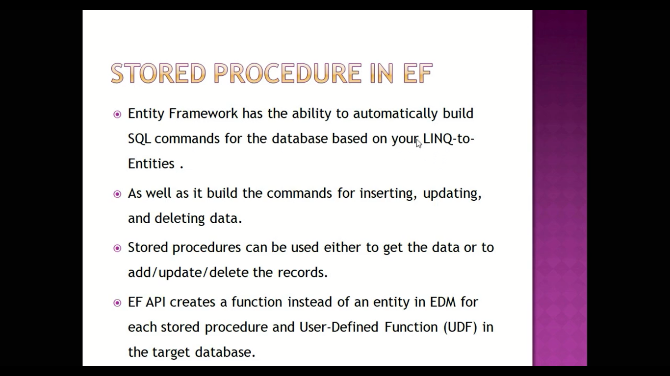

Slide 29
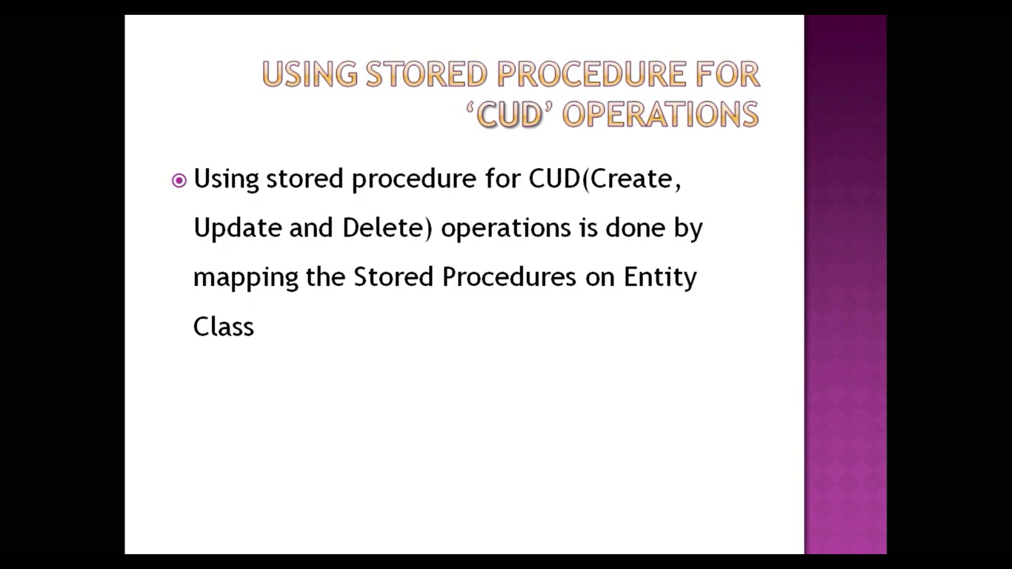

Slide 30
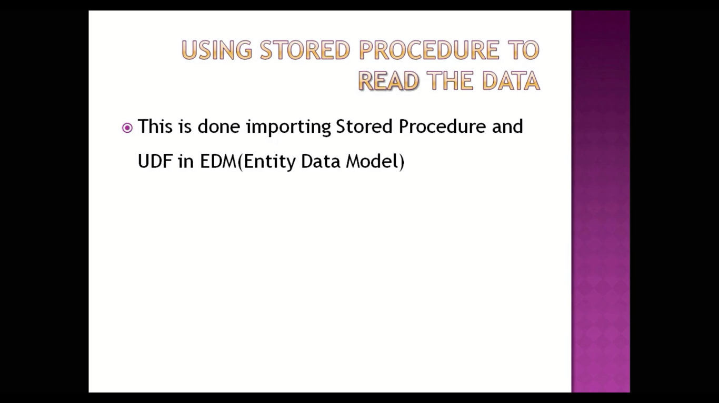

Slide 31
Insert Procedure
Create procedure InsertArea
(
@areaname nvarchar(max),
@cityid int,
@pincode varchar(6)
)
as
Begin
Insert into Areas(AreaName, CityId,Pincode)
VALUES (@areaName, @cityId,@pincode)
End

Slide 32
Update Procedure
Create procedure UpdateArea
(
@areaid int,
@areaname nvarchar(max),
@cityid int,
@pincode varchar(6)
)
as
begin
Update Areas
Set AreaName=@areaname,
CityId=@cityid,
Pincode=@pincode
where AreaId=@areaid
End

Slide 33
Delete Procedure
Create procedure DeleteArea
(
@areaid int
)
as
begin
Delete from Areas where AreaId=@areaid
End

Slide 34
Select All Procedure
Create procedure SelectArea
as
Begin
select *
from Areas
End

Slide 35
Create this four procedure and go to edmx diagram and right click =>update Model from DB
Now for Mapping Stored Procedure Right Click on Entity
And select Insert Update and delete Procedure and also selct every procedures property
Then Click on Validate Option

Slide 36
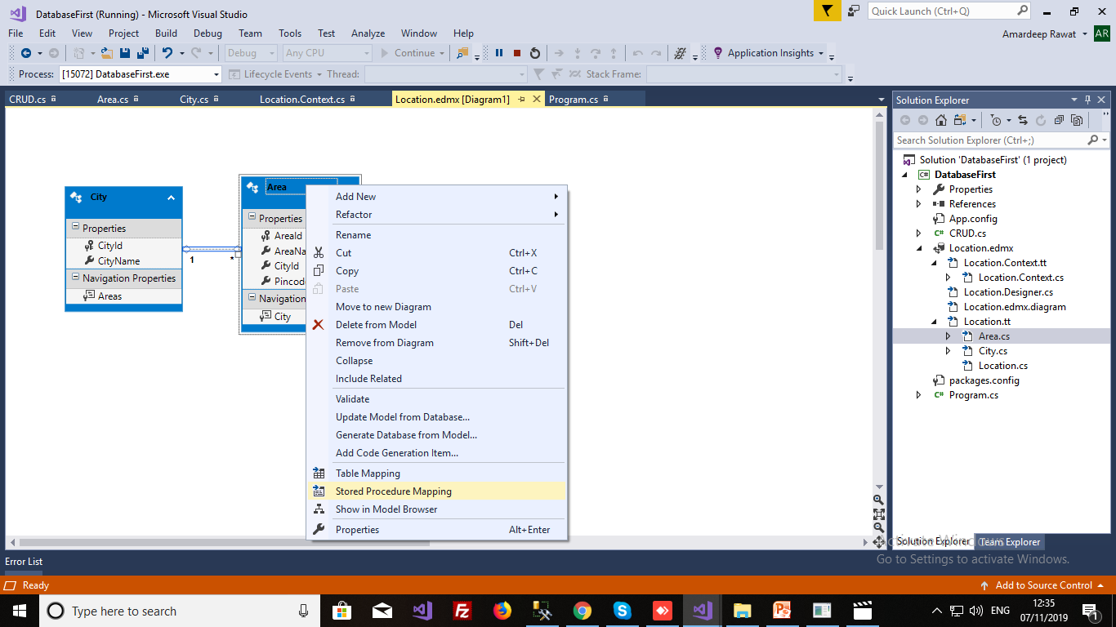

Slide 37
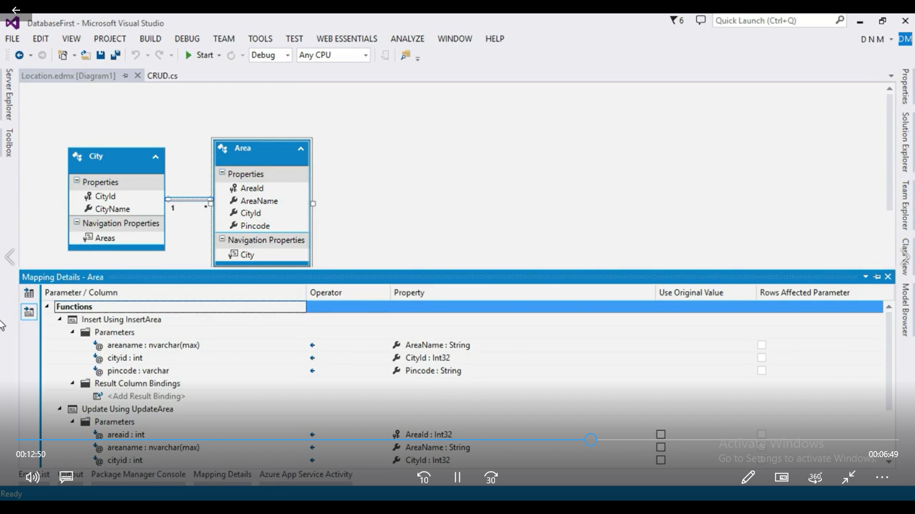

Slide 38
Reading A record from DataBase
Right Click on any area and click on update model from DB and select Stored procedure of Select
To determine whether the procedure is mapped or not we can check using ModelBrowser
Click on Empty Area =>Model Browser
And In Function Import Folder we can see Create Procedure
Now to do the setting of Our Select procedure to return Area we will do Right Click on SelectArea procedure =>Edit=>Select Entities=>Area
Now Just call Select Area Function in your CRUD class to get the details
foreach(Area a in db.SelectArea())

Slide 39
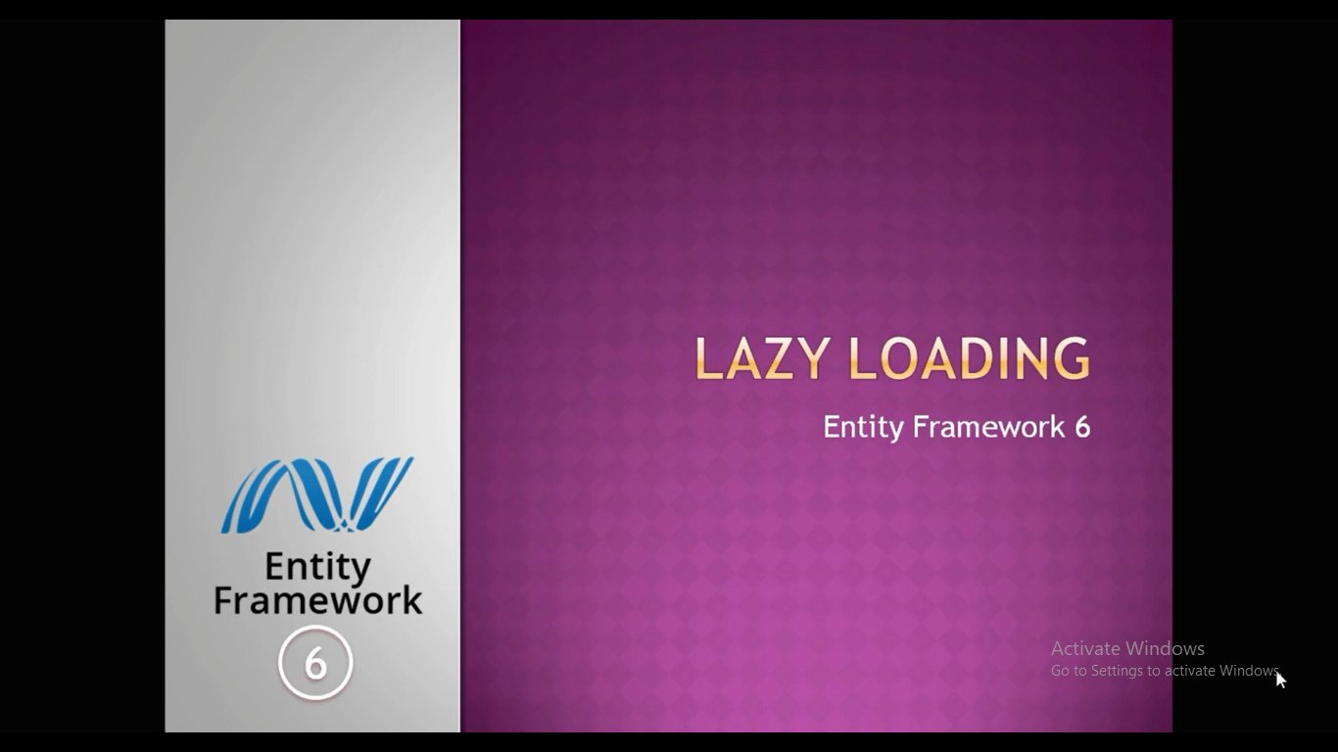

Slide 40
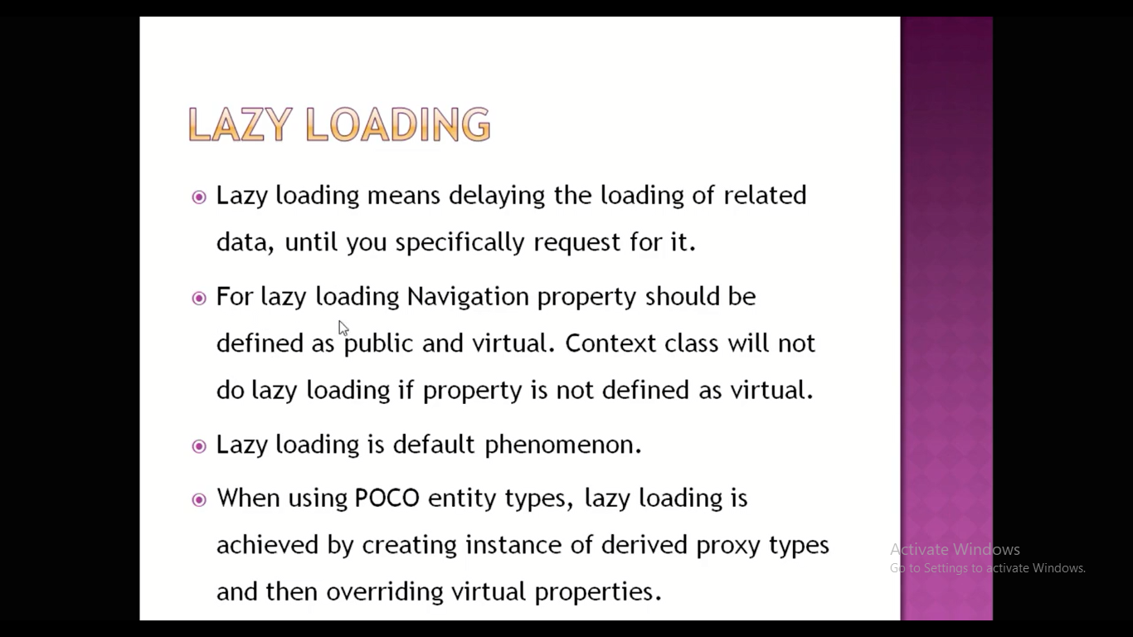

Slide 41
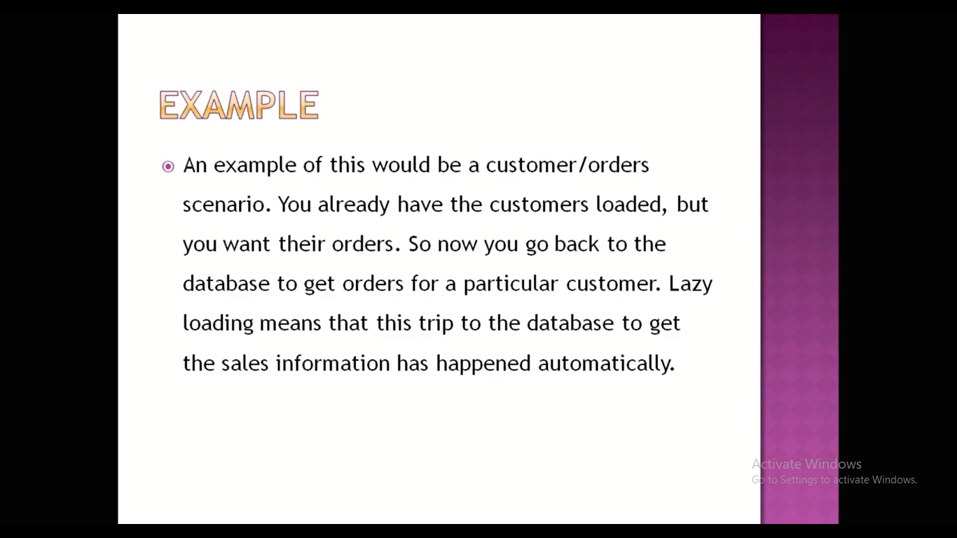

Slide 42
using System;
using System.Collections.Generic;
using System.Linq;
using System.Text;
using System.Threading.Tasks;
namespace DatabaseFirst
{
class LazyLoading
{
public static void Main(string[] args)
{
MyDbEntities db = new MyDbEntities();
foreach (City cobj in db.Cities)
{
Console.WriteLine("{0}\t{1}",cobj.CityId,cobj.CityName);
foreach (Area aobj in cobj.Areas)
{
Console.WriteLine(aobj.AreaName);
}
}
Console.ReadLine();
}
}
}
In Lazy loading a related data is not loaded immediately , it is loaded lazilly when we request for it, so whenever your related data is vast in Amount, Go For lazy Loading and if your realted data is small in Amount we can use Eager Loading
Lazy Loading delays the loading of related entities , It only loads the related Entities , whenever we request
So here for every City, there will be a round trip to fetch the areas of the corresponding city

Slide 43


Slide 44
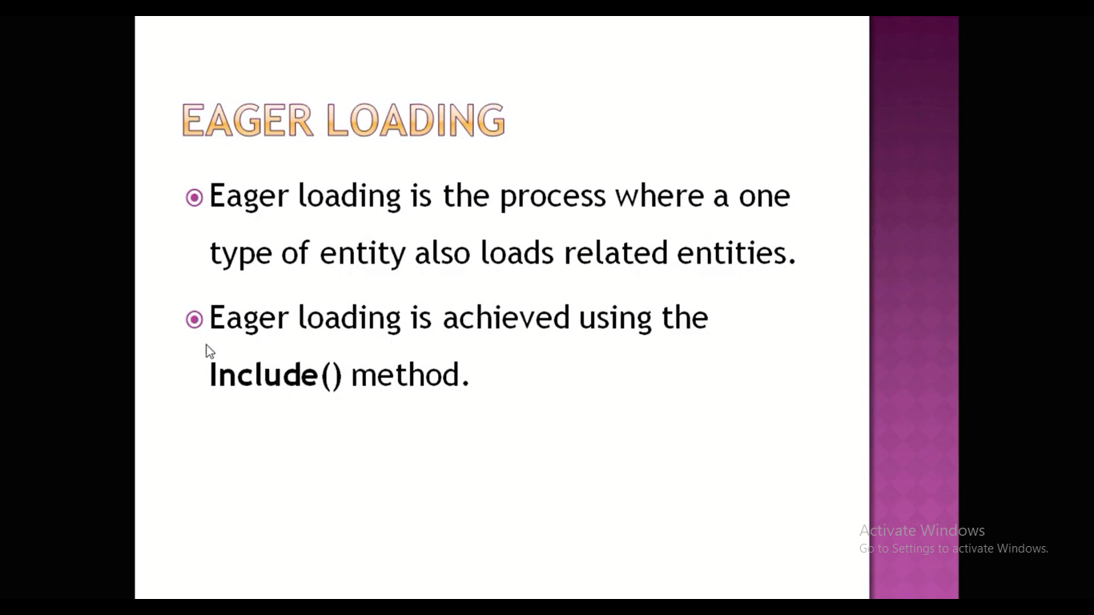
Eager Loading will fetches the data of related Entities at a one time or in one DB Request
So when the data is in less amount go for Eager Loading else go for Lazy Loading

Slide 45
using System;
using System.Collections.Generic;
using System.Linq;
using System.Text;
using System.Threading.Tasks;
namespace DatabaseFirst
{
class EagerLoading
{
public static void Main(string[] args)
{
MyDbEntities db = new MyDbEntities();
foreach (City cobj in db.Cities.Include("Areas"))
{
Console.WriteLine("{0}\t{1}", cobj.CityId, cobj.CityName);
foreach (Area aobj in cobj.Areas)
{
Console.WriteLine(aobj.AreaName);
}
}
Console.ReadLine();
}
}
}

Slide 46
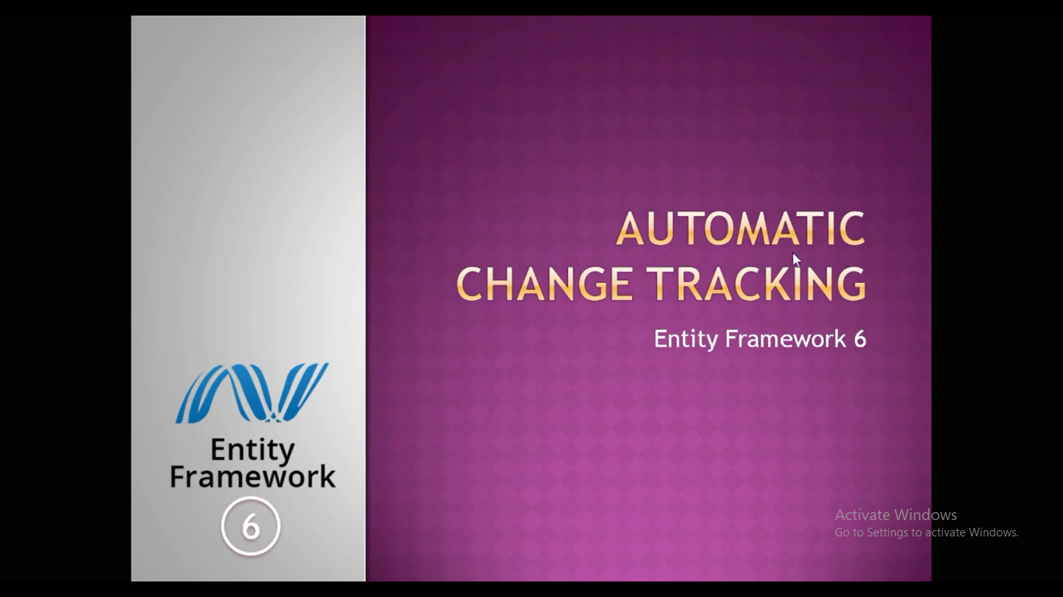

Slide 47
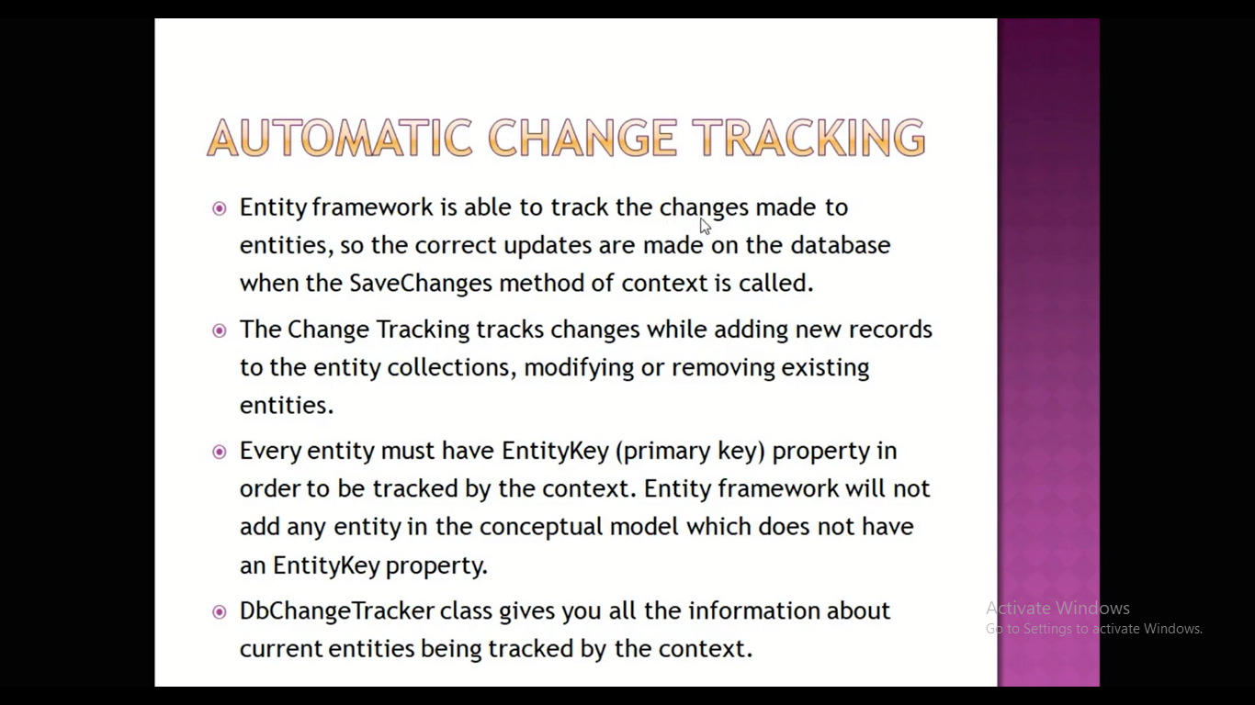

Slide 48
In this practical we will make a changes in Area Entity and we will see how that changes get there or we will add one entity and we will modify the existing entity as well as we will delete the entity and then we will print the states of our entity that are track by oue Entity Framework using DB Change Tracker

Slide 49
using System;
using System.Collections.Generic;
using System.Linq;
using System.Text;
using System.Threading.Tasks;
namespace DatabaseFirst
{
class AutoChangeTracking
{
public static void Main(string[] args)
{
MyDbEntities db = new MyDbEntities();
Area newArea = new Area() { AreaName = "Oxford Street", CityId = 4, Pincode = "123456" };
db.Areas.Add(newArea);
Console.WriteLine("After Adding");
foreach (var tracker in db.ChangeTracker.Entries<Area>())
{
Console.WriteLine(tracker.State);
}
Area modifiedArea = db.Areas.Find(3);
if (modifiedArea != null)
{
modifiedArea.Pincode = "124522";
Console.WriteLine("After Modification");
foreach (var tracker in db.ChangeTracker.Entries<Area>())
{
Console.WriteLine(tracker.State);
}
}
Area delArea = db.Areas.Find(1);
if (delArea != null)
{
db.Areas.Remove(delArea);
}
Console.WriteLine("After Deletion");
foreach (var tracker in db.ChangeTracker.Entries<Area>())
{
Console.WriteLine(tracker.State);
}
Console.ReadLine();
}
}
}

Slide 50
